Slide 1
Loan Approval Prediction
Based on Machine Learning Approach
Quach Bao Thanh
Sep 6, 2023

Slide 2
Agenda
. Plane
. Analysis
. Construct
. Modelling
. Summary

Slide 3
Plane
In this topic, our primary objective is to harness the potential of the provided dataset order to build a machine-learning model to predicting loan approval status.
The procedural steps in this section are data exploration, preprocessing, meticulous model selection, and rigorous performance evaluation.

Slide 4
What are the principal factors influencing the approval or rejection of loan applications?
. Can we harness the power of machine-learning to foresee loan approval outcomes with precision and reliability?
. Does the dataset reveal noteworthy disparities in loan approval rate between:
- Graduates and non-graduates
- Self-employed and non-self-employed
- Annual Income
- Loan term
- Credit score
. What is the most important factor that affect loan approval.

Slide 5
Exploratory Data Analysis (EDA)
We going to give a deep dive into the dataset to uncover meaning full patterns, correlations, and insights. Investigate the impact of factors on loan status by visualization via pie charts, scatter plots, …

Slide 6
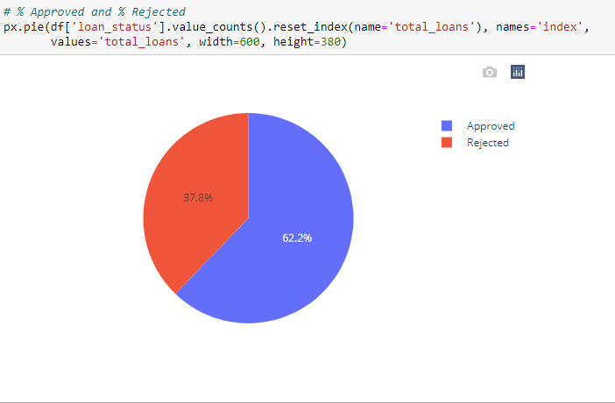
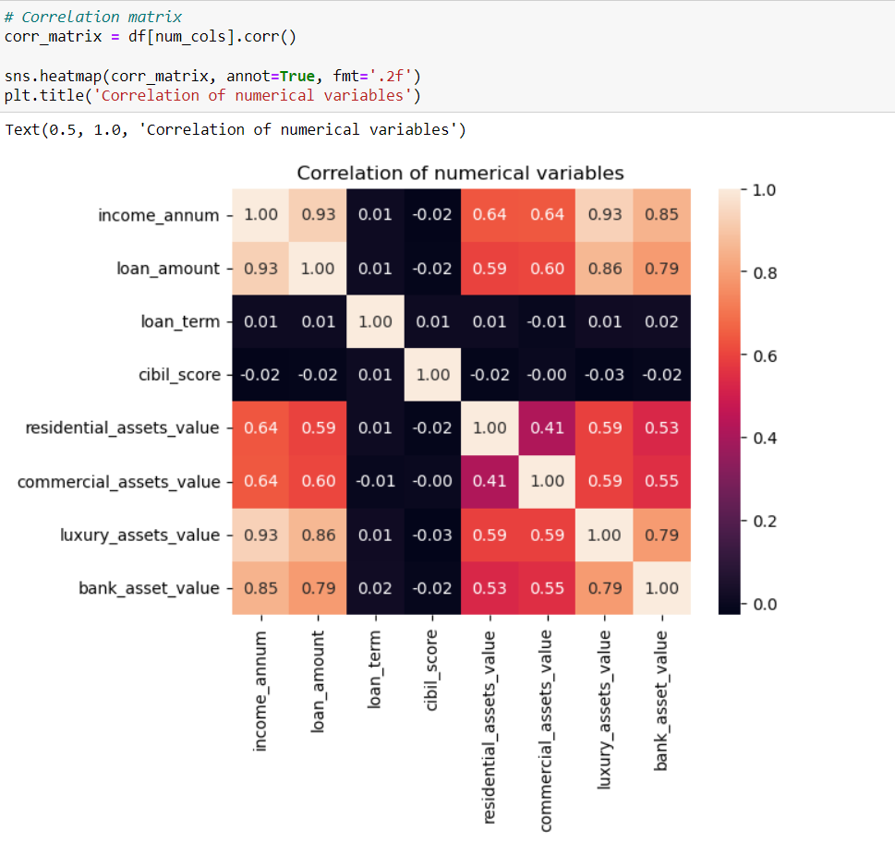
Pie chart showing the % of Approved and Rejected loan status
There is clearly correlation between loan amount and income amount. Higher incomes are more likely to apply for larger loans

Slide 7
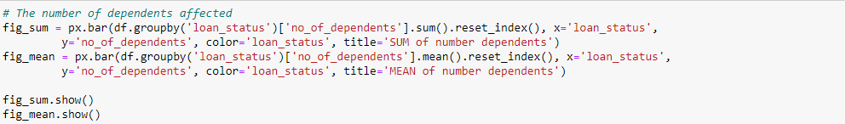
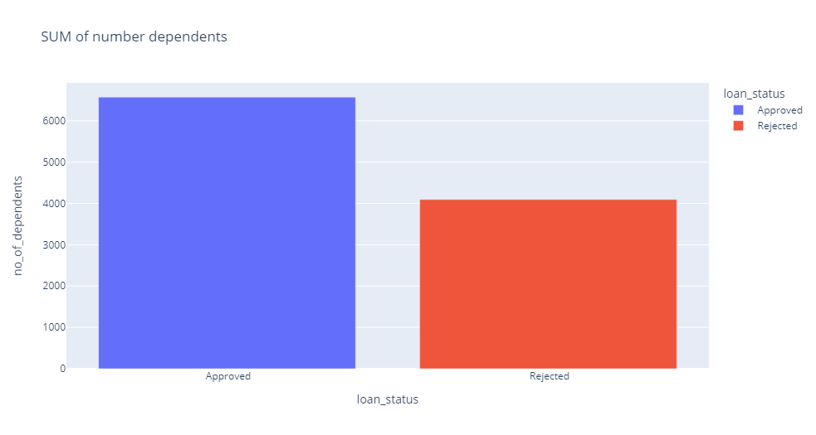
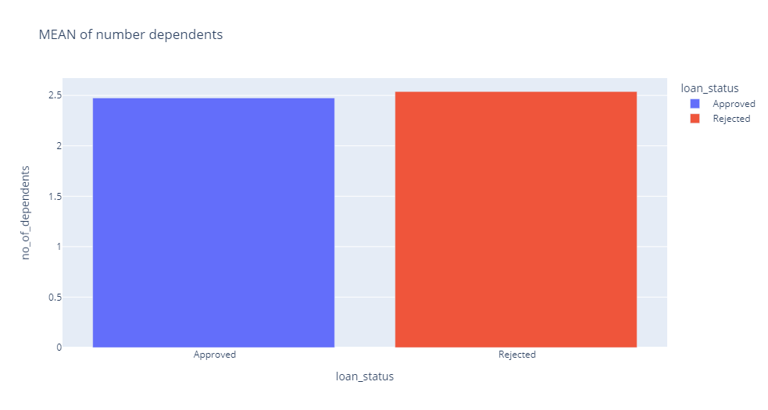
Insight: We can observe that approved status tend to have a higher number of dependents compared to rejected. However, the average bar chart show that dependents for approved is roughly equivalent to rejected. Consequently, we can conclude that there is no strong correlation between loan status and the number of dependents.

Slide 8
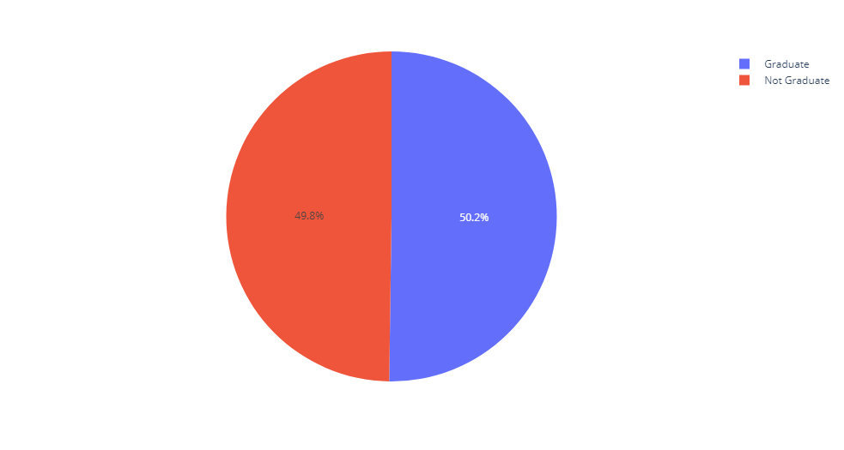
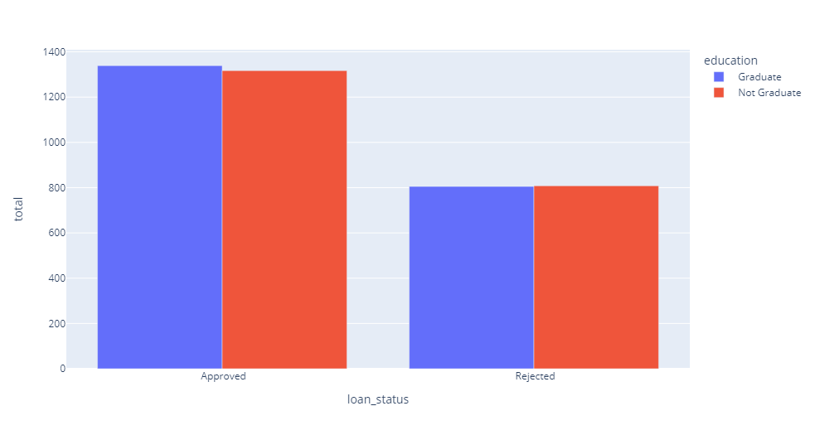
Insight: We can see clearly that education does not appear to have a significant impact on loan status

Slide 9
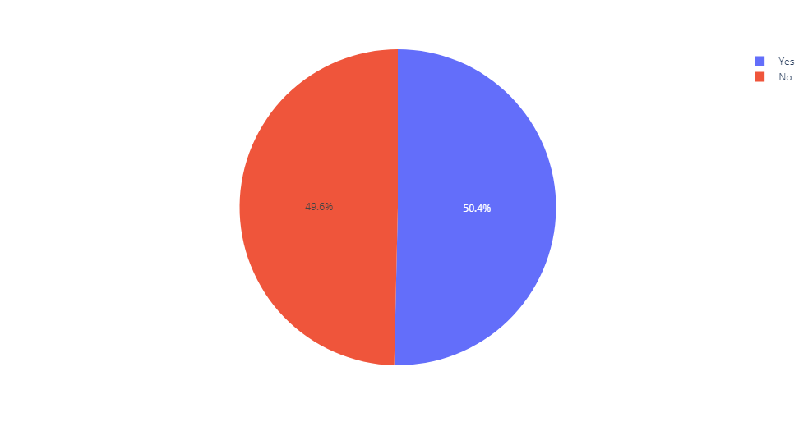
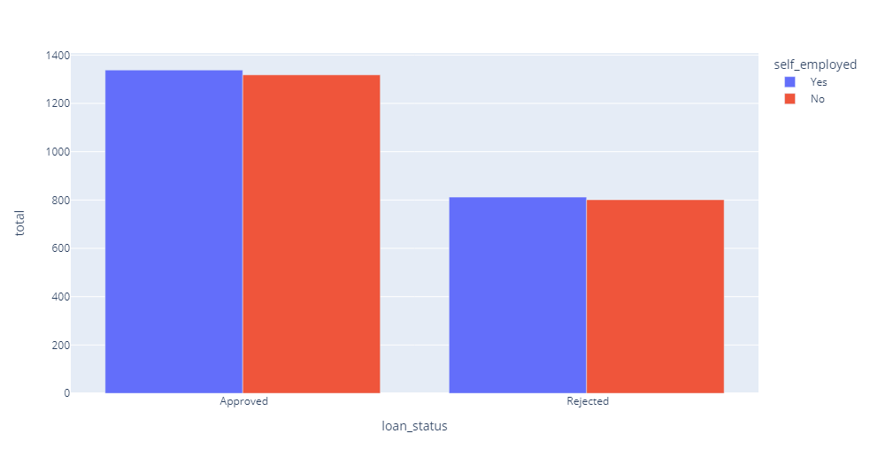
Insight: Both loan status categories, approved and rejected, there is fairly even distribution between self-employed and non-self-employed. We can conclude that self-employment status does not appear to have a huge impact on their loan status.

Slide 10
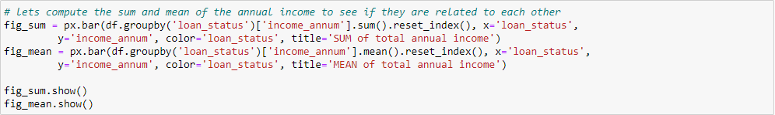

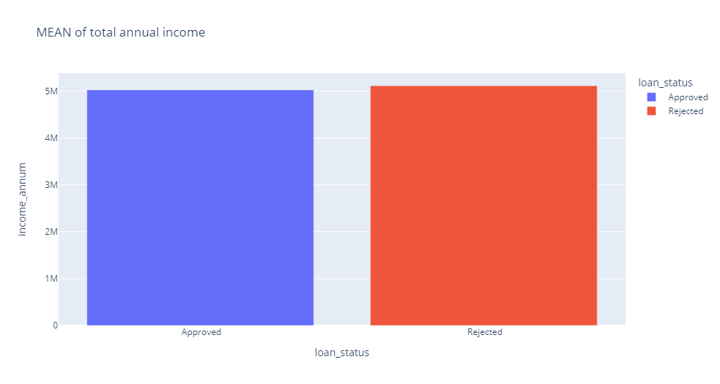
Insight: Approved loans typically have a higher total annual income compared to rejected. However, this difference maybe affect by approved loans in our dataset. When examining of the average bar chart, its clearly that the annual income for approved is approximately equal to rejected. Therefore, we can conclude that there is no strong correlation between loan status and annual income.

Slide 11
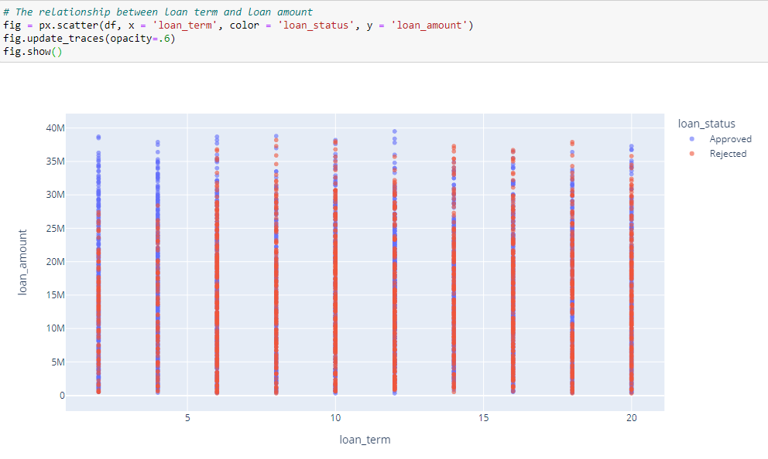
Insight: The scatter plot reveals that there is no significant concentration of rejected loans within specific loan term intervals, instead, approved and rejected are spread out across the various term durations.

Slide 12
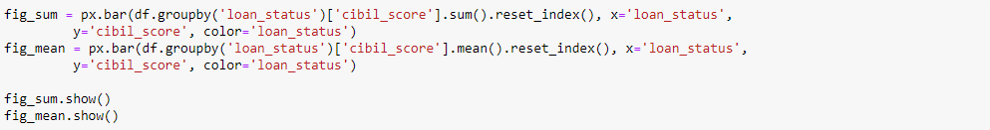
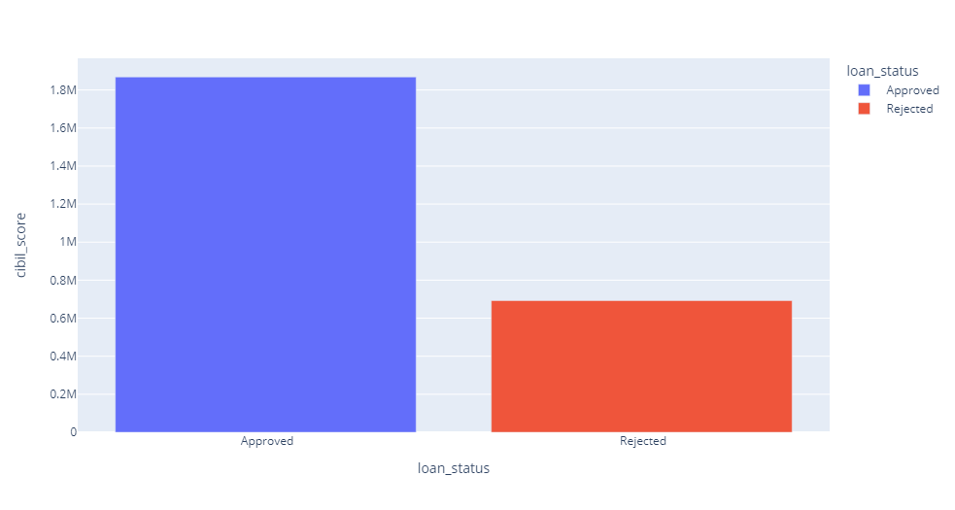
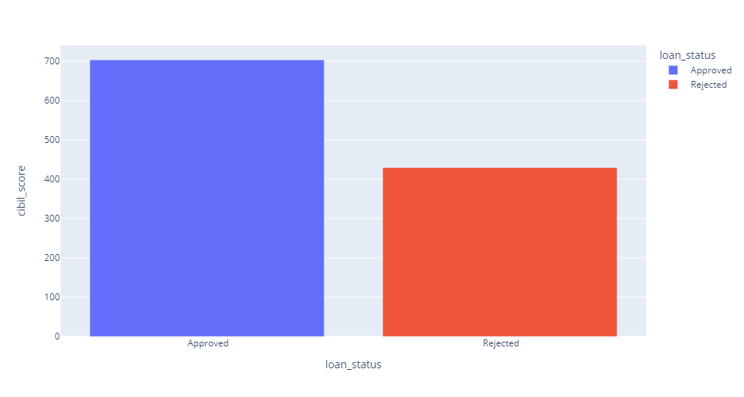
Insight: This pattern strongly show that cibil score do a pivotal role in the loan approval process. Higher score favoring a loan approval and lower score being associated with loan rejection.
So finally, does cibil score a strong evidence for determining the loan status?

Slide 13
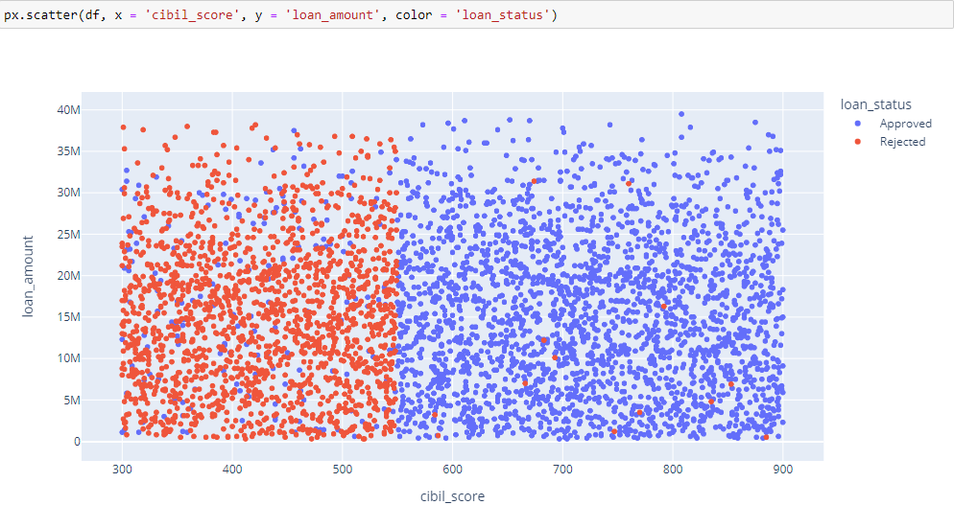
This scatterplot clearly provides separation between approved and rejected loan base on cibil score.The line appears to be drawn at a score of ~550 indicating that the majority of approved have a cibil score higher than 550, while rejected tend to have a score below 550. This suggests that loan approval are influenced significant by cibil score.

Slide 14
Construct
We will construct various models and assess their performance to identify the most suitable one for our dataset. The initial models to be considered are:
. Logistic Regression
. Support Vector Machine
. KNN - KNeighbors
. Decision Tree
. Random Forest
. Ada Boost

Slide 15
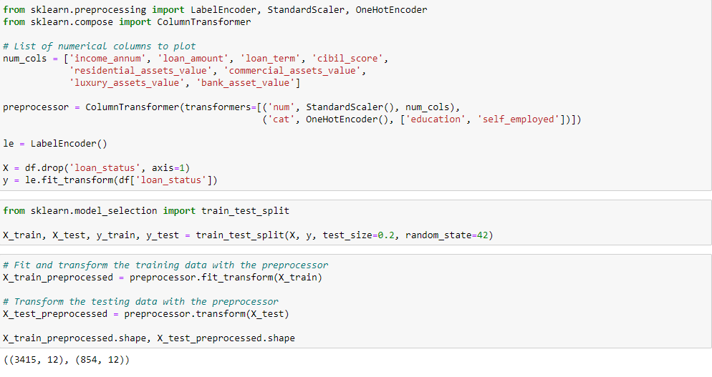
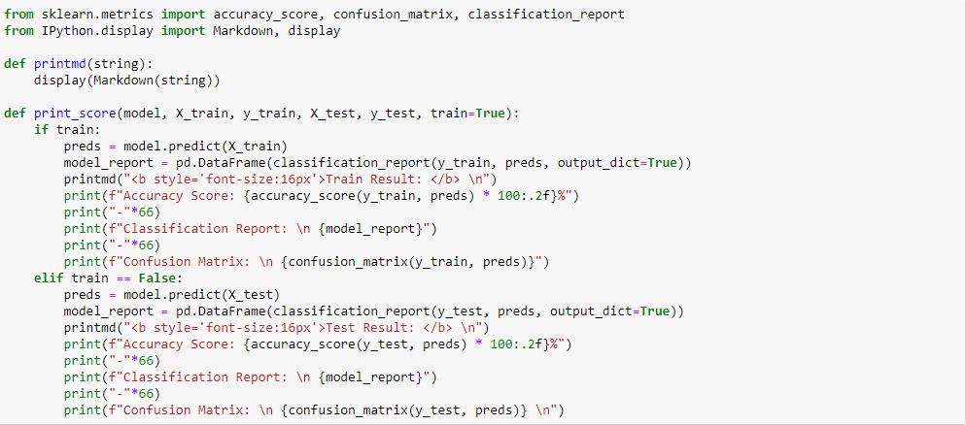
Data Preprocessing

Slide 16
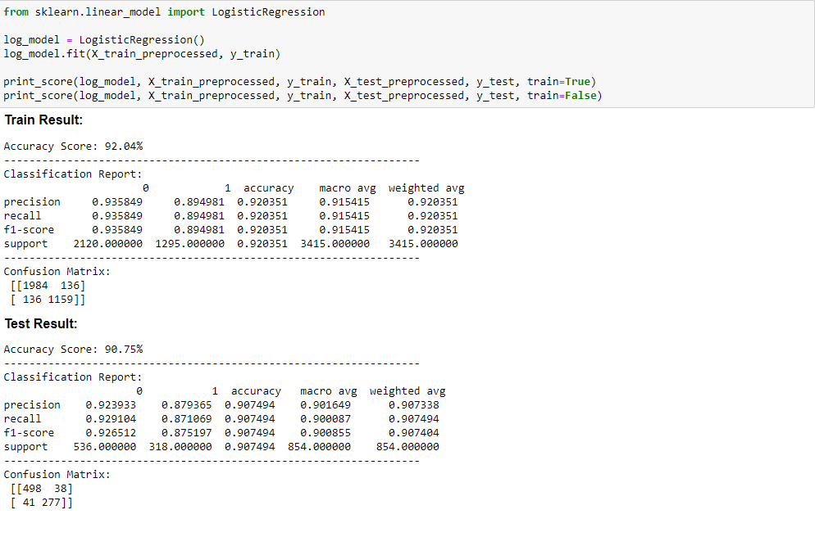
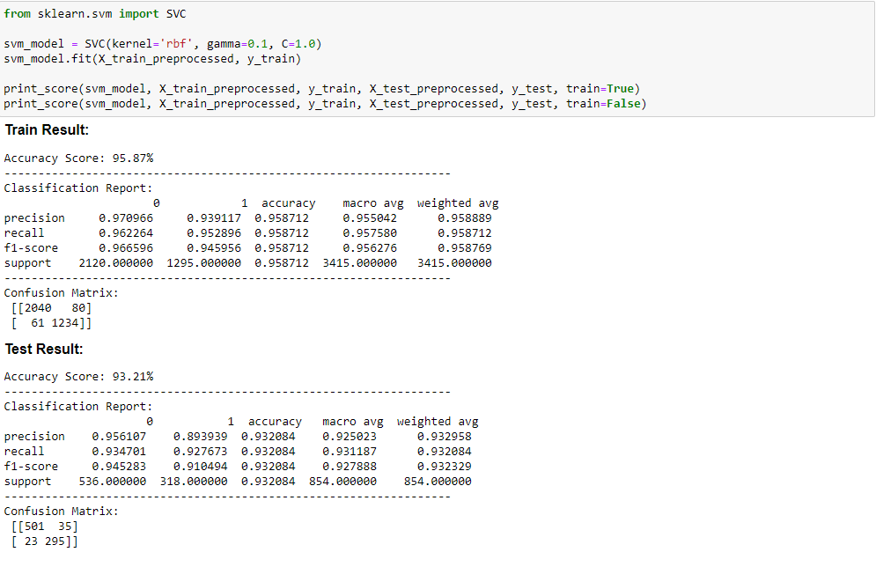
Logistic Regression
Support Vector Machine
Accuracy Score: 90.75%
Accuracy Score: 93.21%

Slide 17
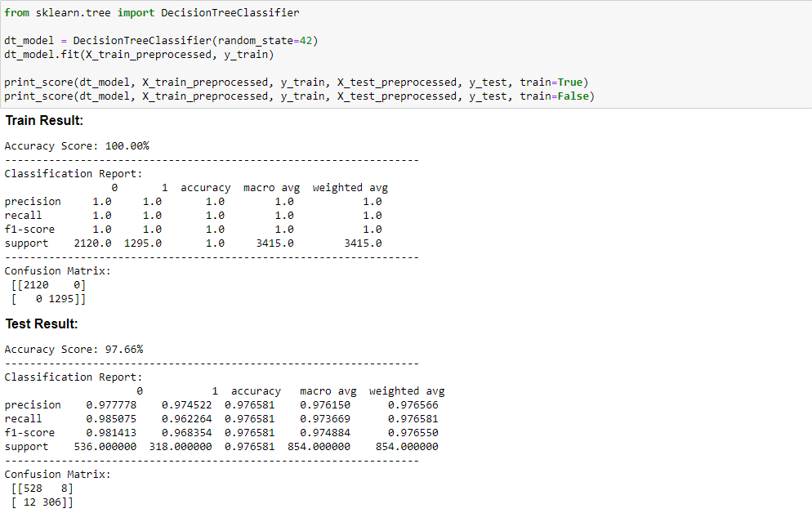
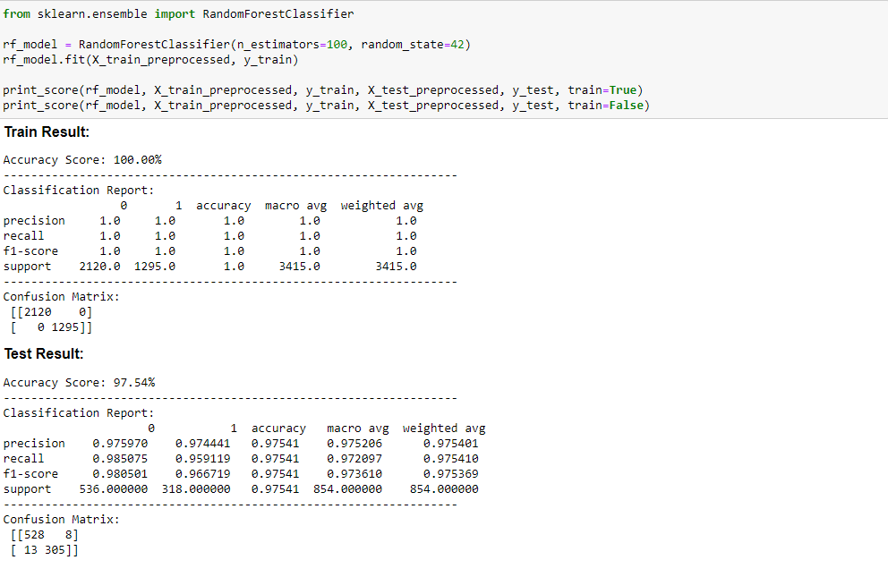
Decision Tree
Random Forest
Accuracy Score: 97.66%
Accuracy Score: 97.54%

Slide 18
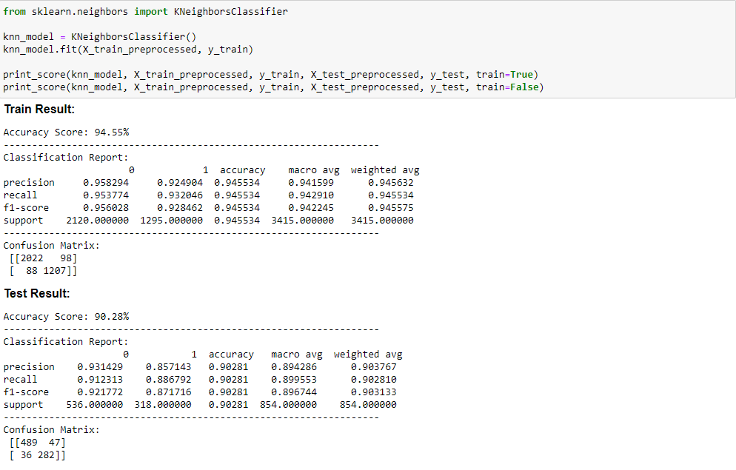
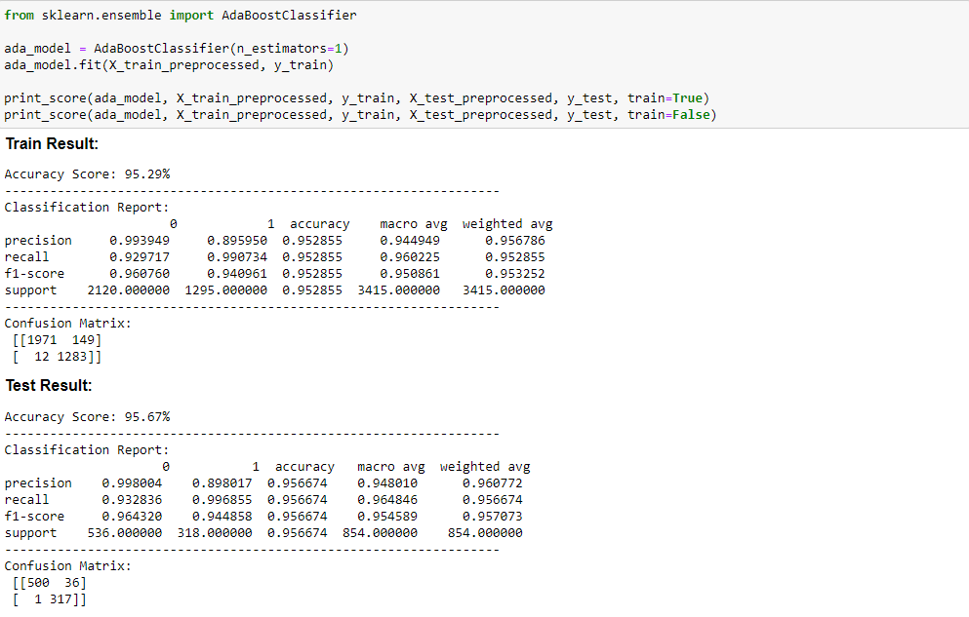
KNN
Ada Boost
Accuracy Score: 90.28%
Accuracy Score: 95.67%

Slide 19
Summary
We got 2 models has high accuracy score are Decision Tree and Random Forest with 97%.

Slide 20
Thank you
Quach Bao Thanh

